Slide 1




Week-11 (Discussion)
26th Sept, 2025
Computer Vision
Prof. Jayanta Mukhopadhyay
Professor
Computer Science and Engineering Department
IIT Kharagpur
Ayan Paul
PMRF Research Scholar
IIT Kharagpur

Slide 2
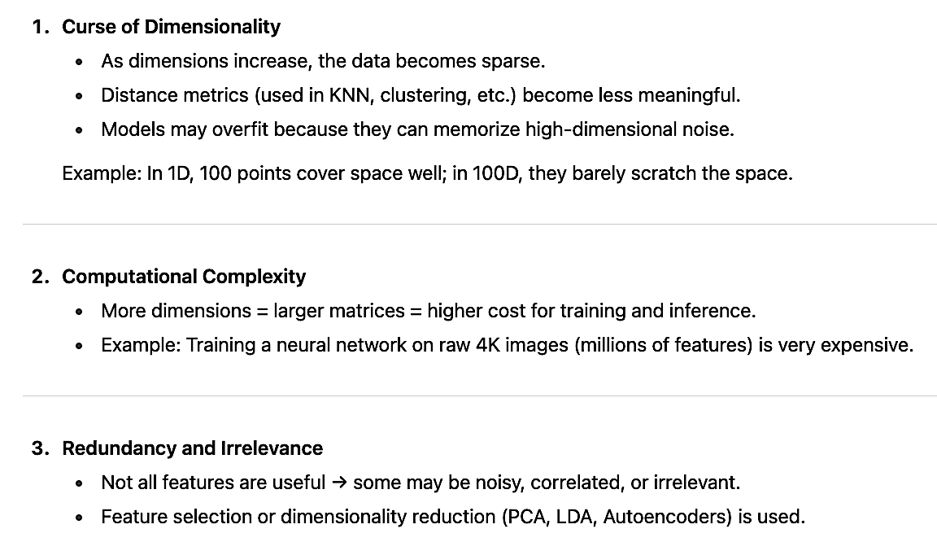
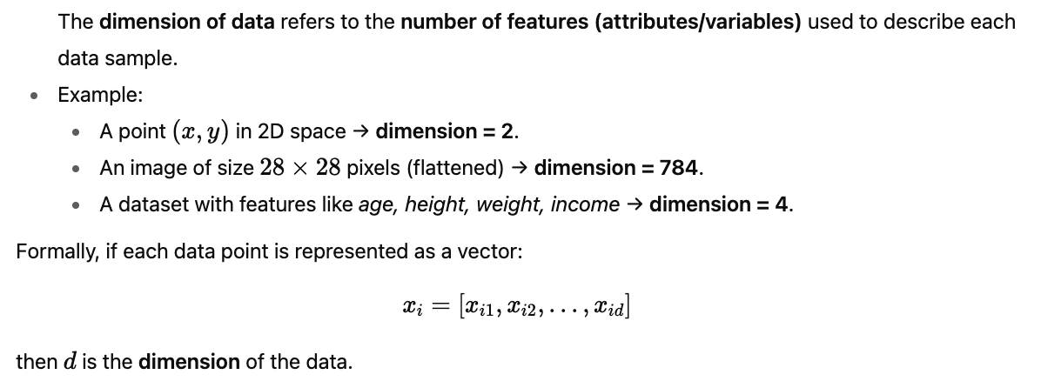
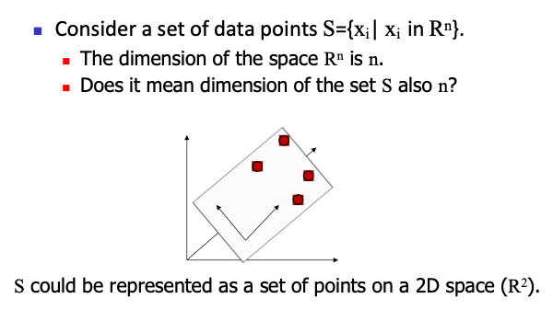
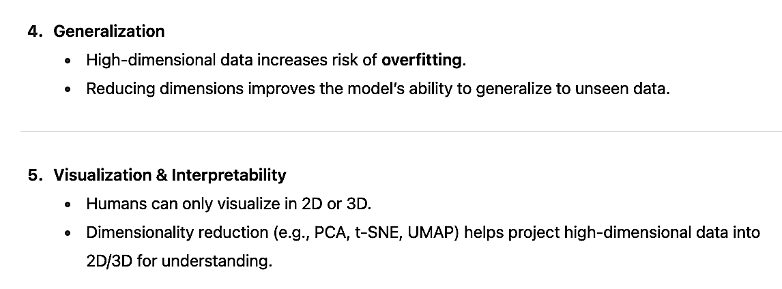
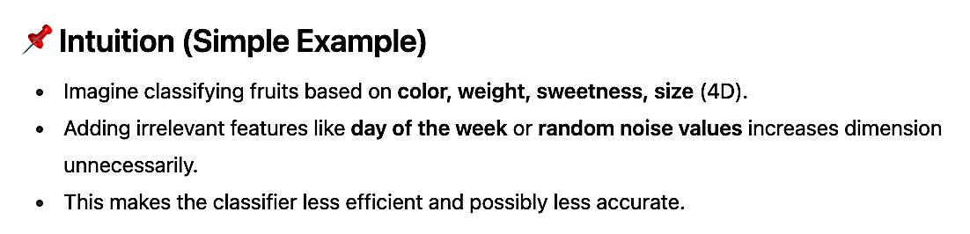
Data dimension
Why Are We Concerned About Data Dimension

Slide 3
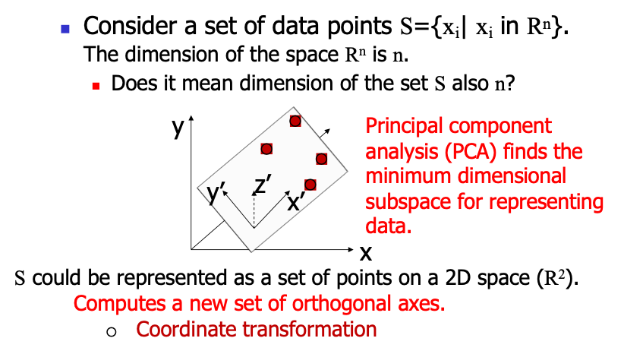
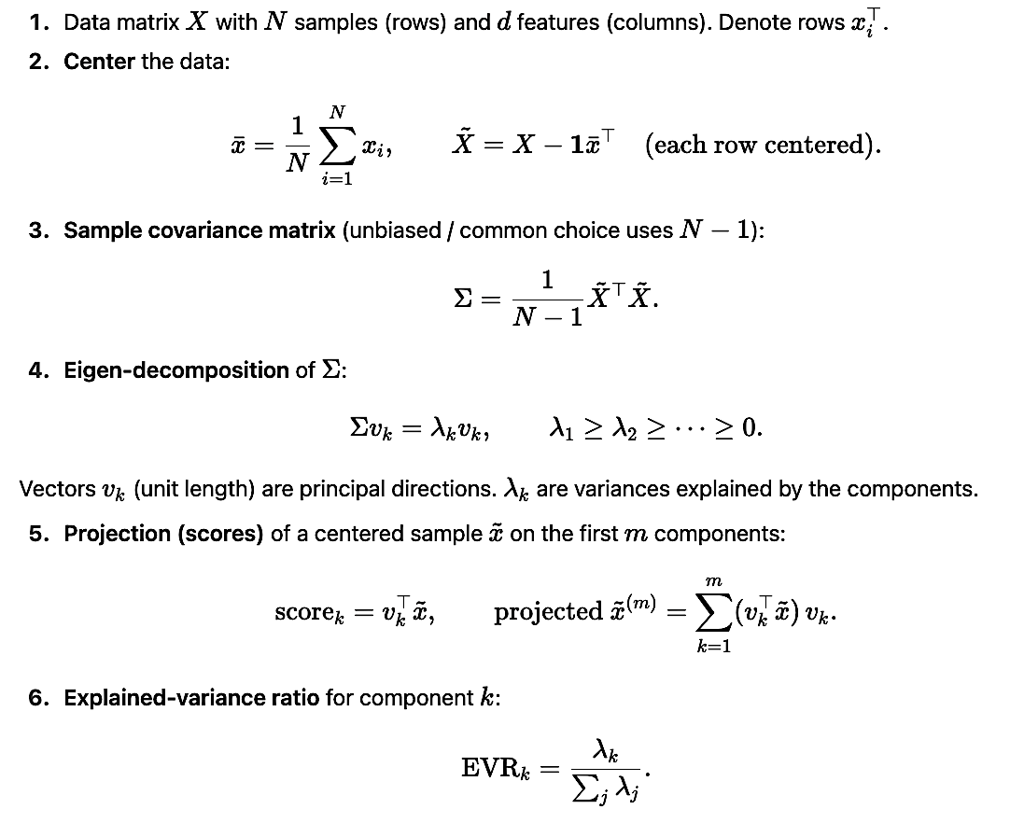
Principal component analysis
PCA (Principal Component Analysis) reduces dimensionality by finding new orthogonal axes (called principal components) along which:
The data has maximum variance (spread).
These axes are uncorrelated (orthogonal).
So PCA transforms the dataset into directions of maximum information while discarding noise/less important directions.
PCA-Algorithm
Input: A set of data points: S={X_{j}=(x_{1j},x_{2j},…x_{nj})| X_{j} in R^{n}}.
Output: A set of k eigen vectors: E_{v}={e₁,e₂,…,e_{k}}
Compute mean of data points.
Translate all data points to their mean.
Compute covariance matrix of the set.
Compute eigen vetcors and eigen values (in increasing order).
Choose k such that the fraction of variance accounted for is more than a threshold.
Use those k-components for representing any data point.

Slide 4
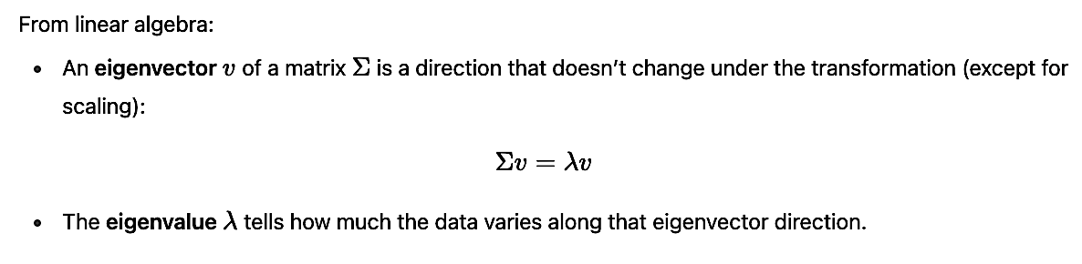
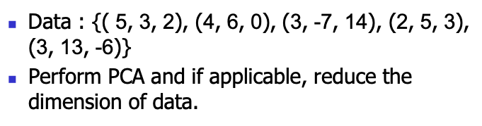
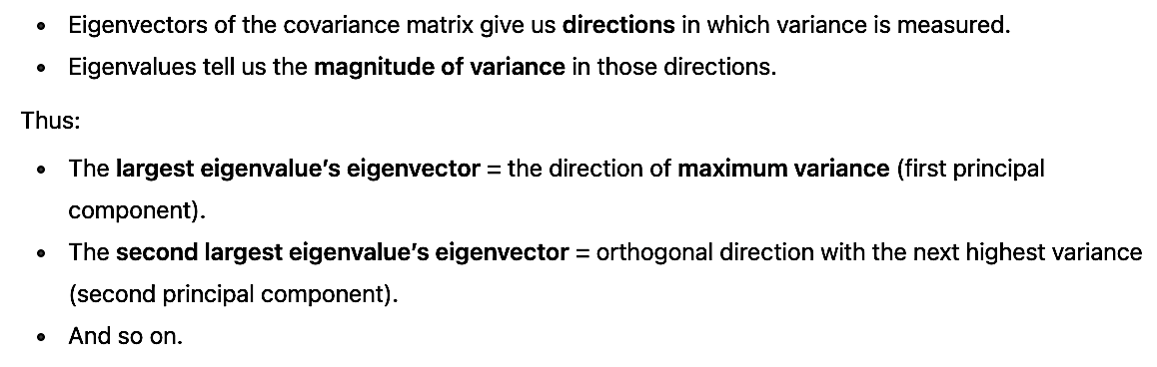
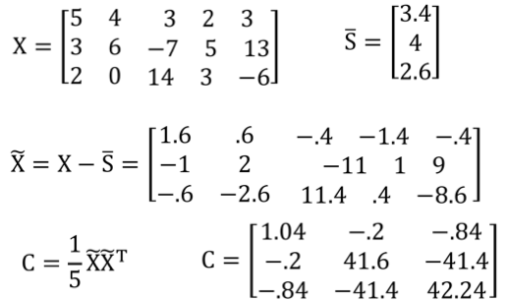
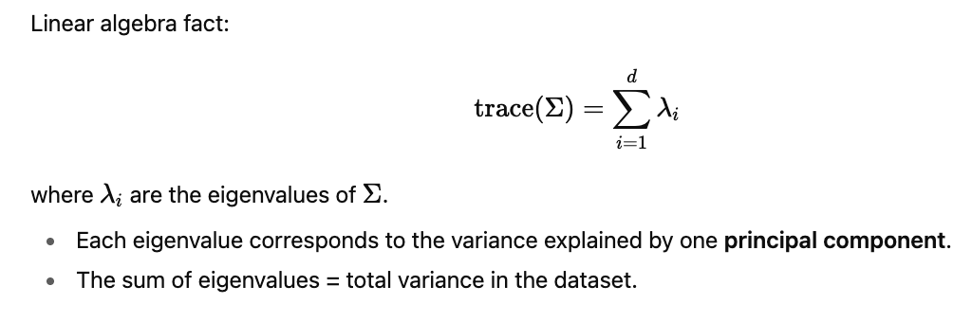
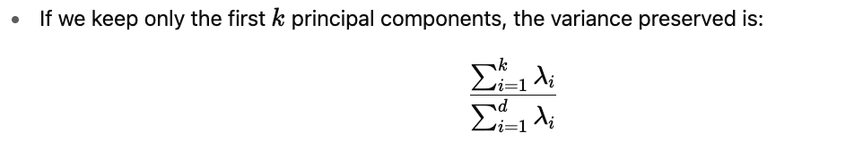
Why Eigenvectors and Eigenvalues?
Exercise - 1
Solution

Slide 5
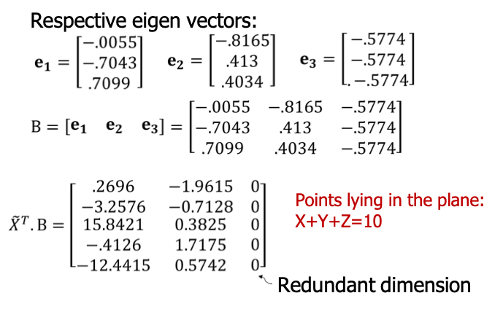
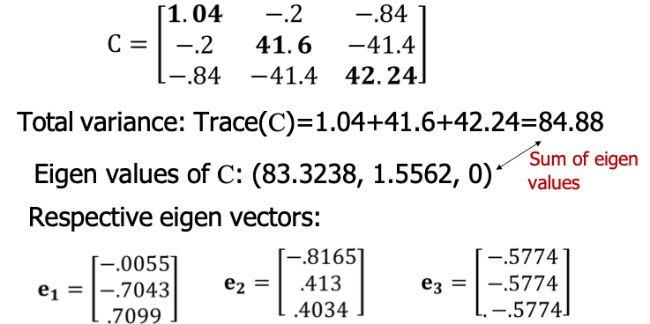
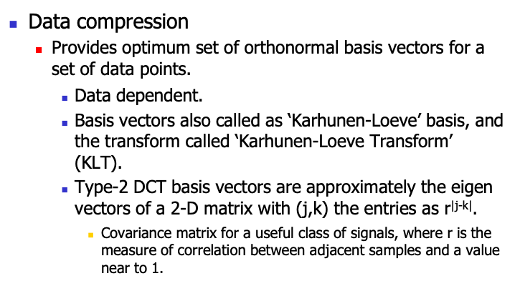
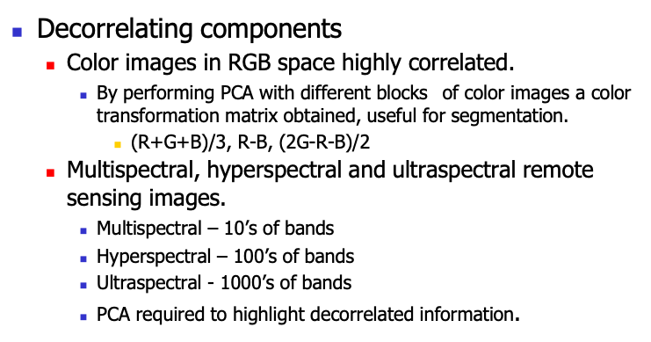
Application of PCA

Slide 6
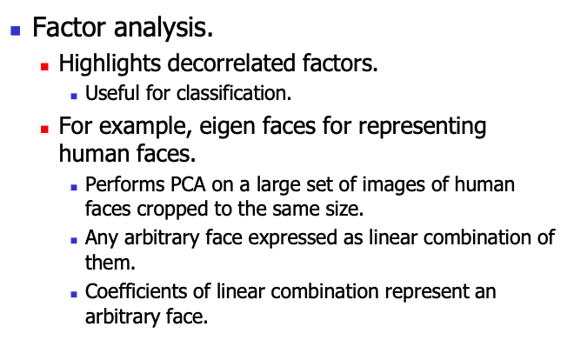
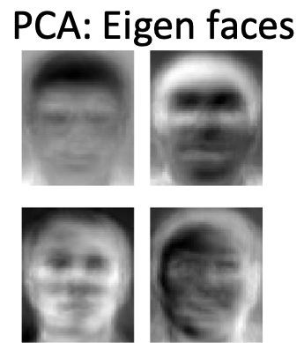
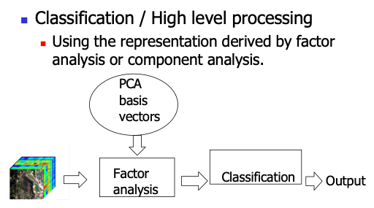
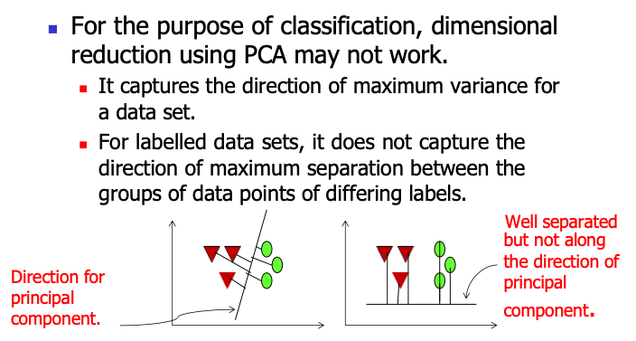
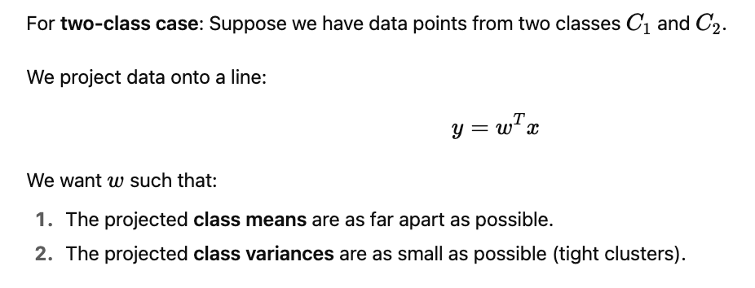
PCA Limitations
Fisher Linear Discriminant Analysis

Slide 7
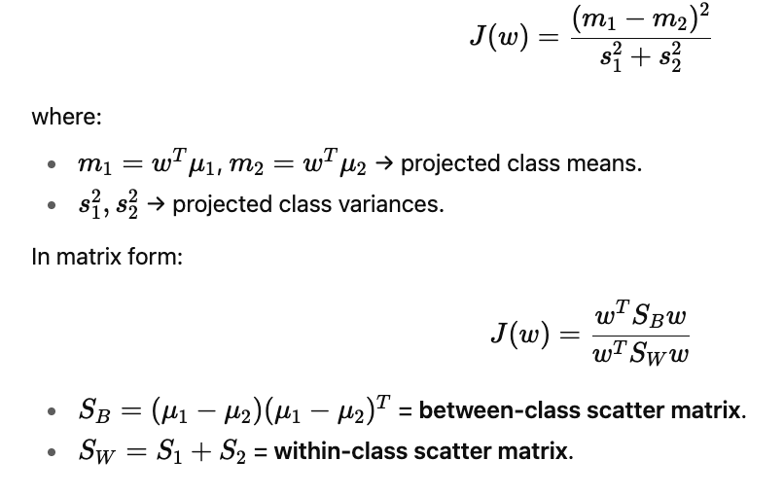
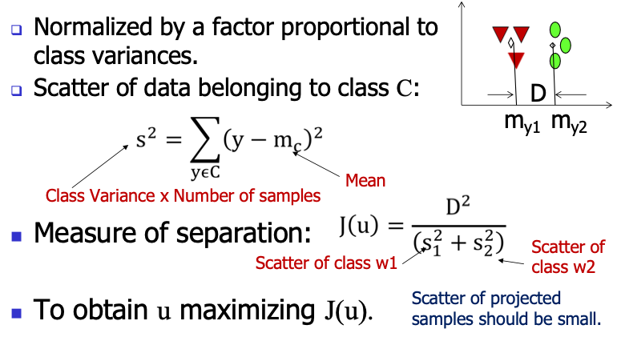
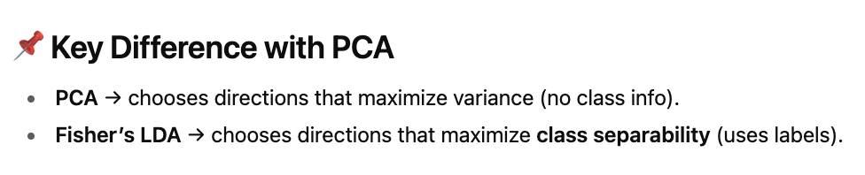
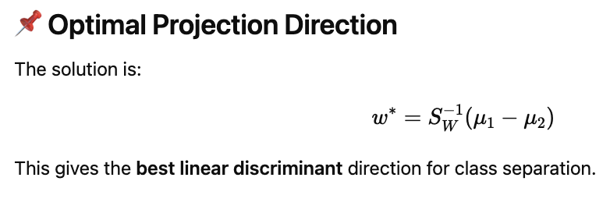
Fisher’s Criterion (Objective Function)

Slide 8
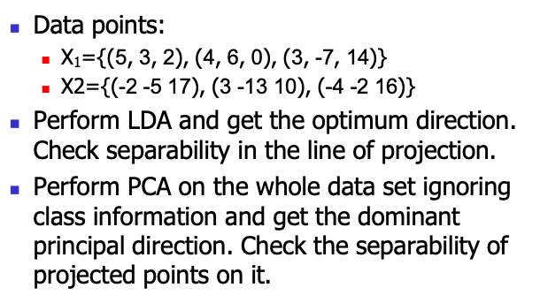
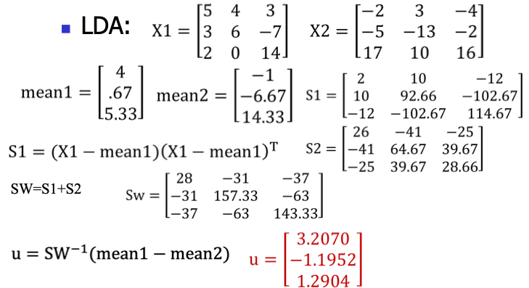
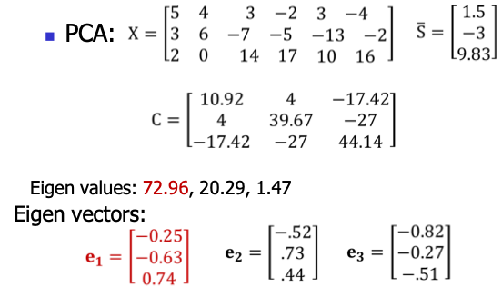
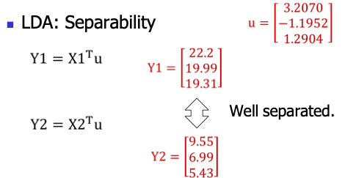
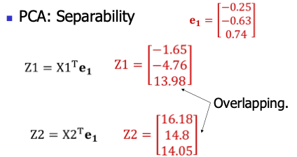
Exercise - 2
Solution

Slide 9
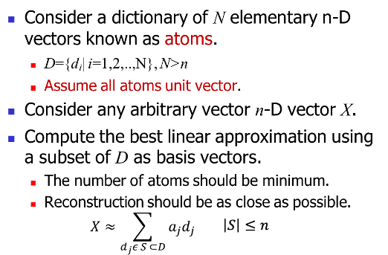
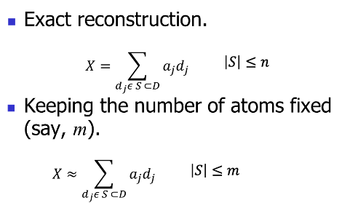
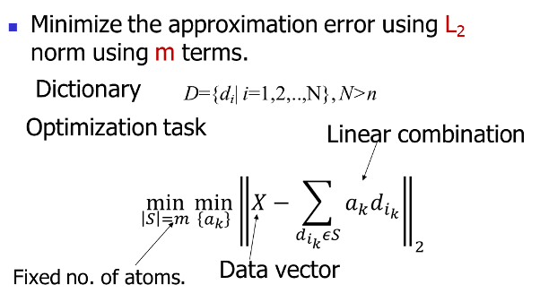
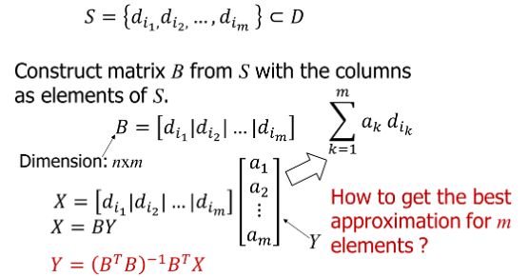
Sparse Representation
Idea: Represent a signal (or data vector) as a linear combination of only a few basis vectors (atoms) from a dictionary, instead of using all basis vectors.
Exact / Approximate Representation
Sparse approximation
Reconstruction given S

Slide 10
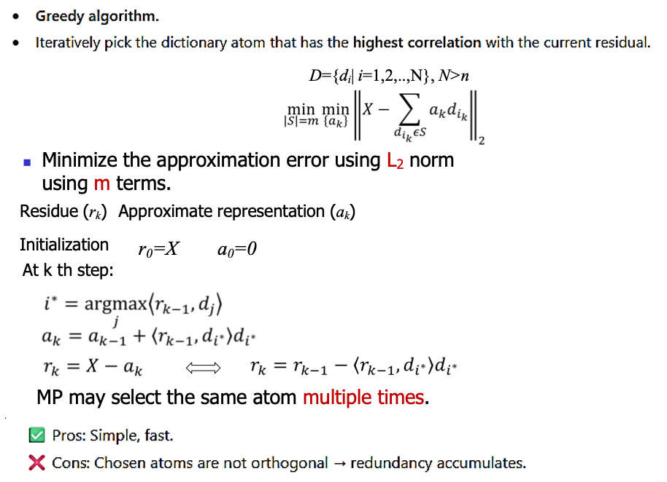
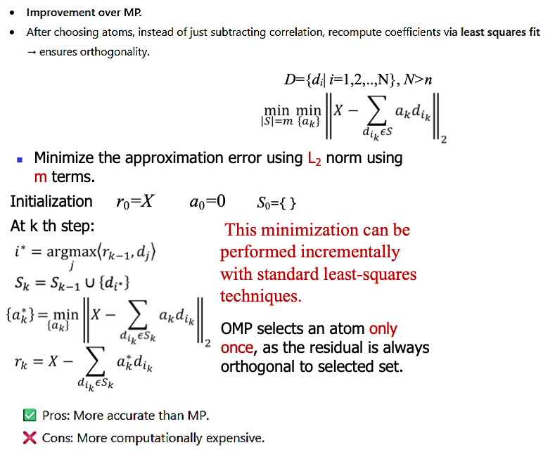
Pursuit Algorithms
Methods that try to find a good (approximate) sparse solution.
Matching pursuit (MP)
Orthogonal Matching Pursuit (OMP)

Slide 11
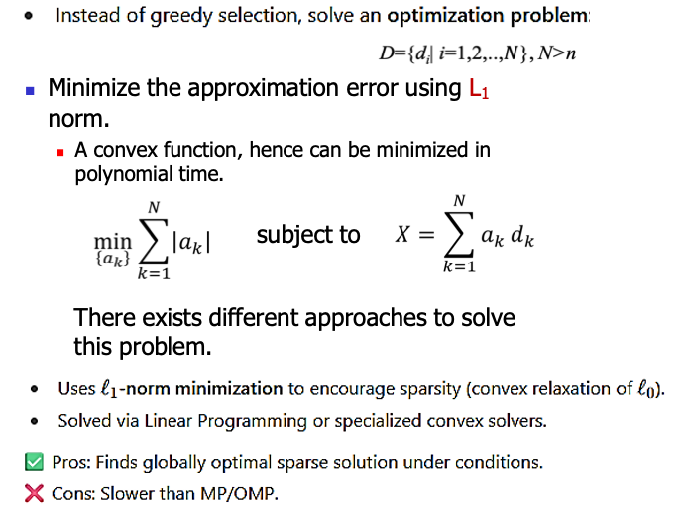
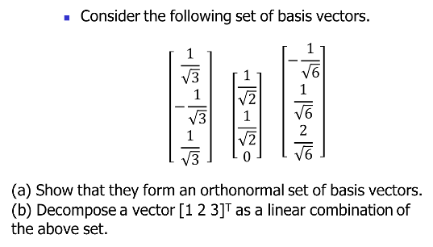
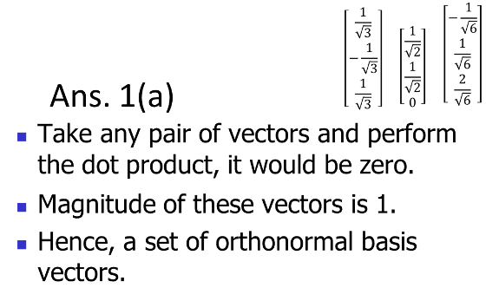
Basis Pursuit (BP)
Exercise - 3
Solution
Algorithm | Strategy | Pros | Cons
MP | Greedy, picks one atom at a time | Simple, fast | Coefficients not optimal
OMP | Greedy + least squares re-fit | Better accuracy | More computation
BP | Convex optimization (ℓ1) | Best recovery under theory | Slow, heavy for large data

Slide 12
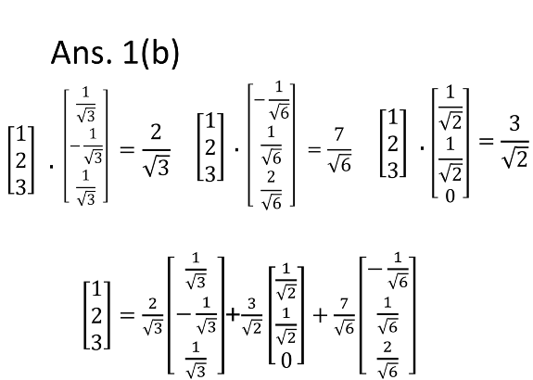
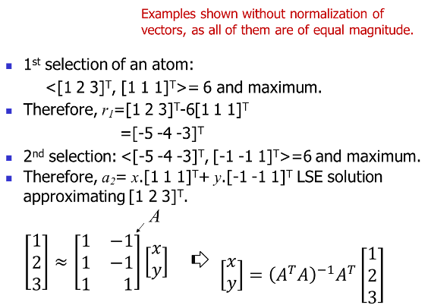
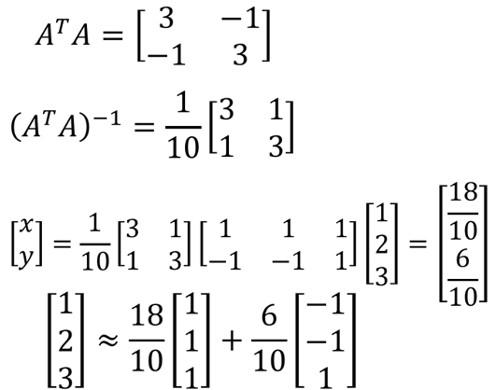
Exercise - 4
Consider a dictionary in a 3-D space consisting of following atoms:
{[ 1 1 1]^{T}, [1 -1 1]^{T}, [-1 -1 1]^{T}, [-1 1 1]^{T}}
Derive the best representation of the vector [1 2 3] using 2 atoms of the above dictionary following orthogonal matching pursuit (OMP).
Solution

Slide 13
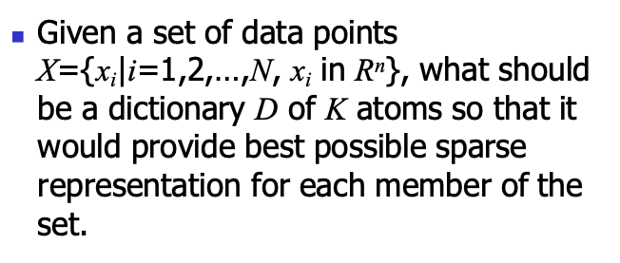
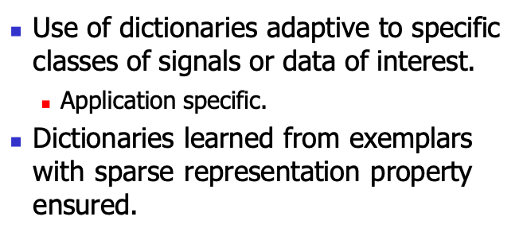
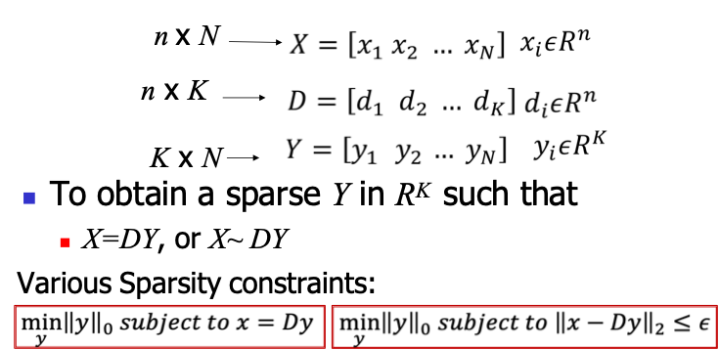
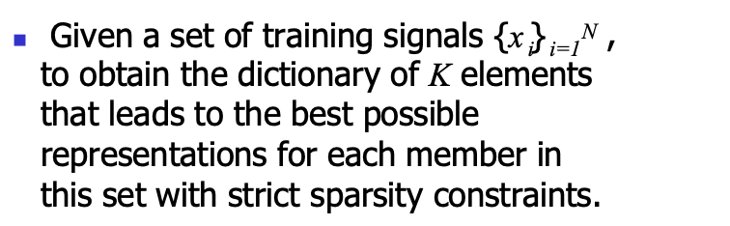
Learning a dictionary
Motivation
Problem Statement
K-SVD: Forming dictionary for sparse representation

Slide 14
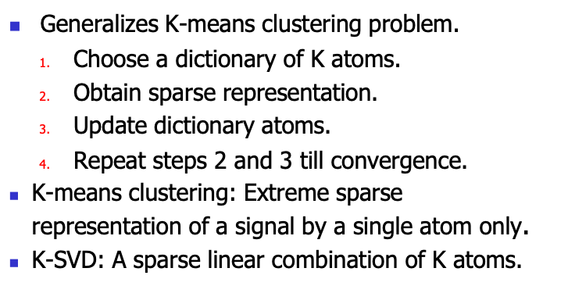
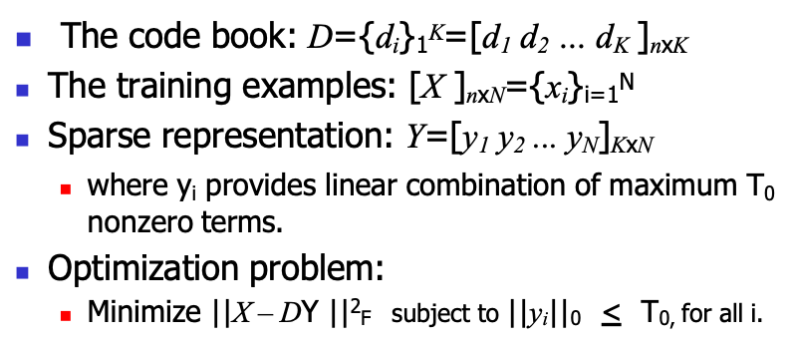
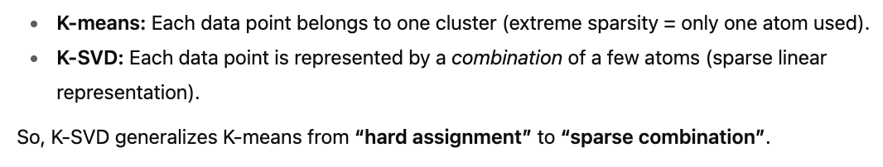


K-SVD
KSVD: Generalization of K-means clustering
K-means clustering

Slide 15


The algorithm
Applications
Compression.
Denoising
Deblurring
Super-resolution
Mapping of learned dictionaries
Inpainting

Slide 16
Topics on which Week 11 Assignment Questions are based
Dimension reduction techniques - Principal Component Analysis and Fisher’s Linear Discriminant Analysis
Sparse representation
Pursuit algorithm - Matching pursuit, Orthogonal matching pursuit, and Basis pursuit
Dictionary learning and sparse representation – K-SVD

Slide 17



QUESTION 1
SOLUTION 1
CORRECT ANSWER 1
a)

Slide 18

QUESTION 2
From the data points given in question 1, what is the total variance in PCA?
a) 4.65
b) 3.336
c) 12.86
d) 1.33
SOLUTION 2
CORRECT ANSWER 2
b)

Slide 19

QUESTION 3
Which of the following are true regarding Principal Component Analysis (PCA)?
a) It finds the minimum dimensional subspace for representing the data.
b) All principal components are orthogonal to each other.
c) It provides the direction along which the data have the largest variance.
d) It computes components along principal axes.
SOLUTION 3
CORRECT ANSWER 3
a), b), c), d)

Slide 20

QUESTION 4
LDA is a parametric method
a) True
b) False
SOLUTION 4
.
CORRECT ANSWER 4
True

Slide 21

QUESTION 5
What is a common application of PCA in data preprocessing?
a) Classification
b) Segmentation
c) Dimensionality reduction
d) Feature selection based on class labels
SOLUTION 5
CORRECT ANSWER 5
c)

Slide 22



QUESTION 6
SOLUTION 6
CORRECT ANSWER 6
a)

Slide 23

QUESTION 7
Which of the following statements is true about the relationship between PCA and LDA?
a) PCA and LDA both maximize class separability
b) PCA and LDA both maximize variance
c) PCA maximizes class separability while LDA maximizes variance
d) PCA maximizes variance while LDA maximizes class separability
SOLUTION 7
CORRECT ANSWER 7
d)

Slide 24



QUESTION 8
SOLUTION 8
CORRECT ANSWER 8
a)

Slide 25
QUESTION 9
OMP is
a) Greedy Algorithm
b) Dynamic Programming Algorithm
c) Divide and Conquer Algorithm
d) None of these
SOLUTION 9
Orthogonal Matching Pursuit (OMP) is a greedy algorithm used in sparse approximation.
At each step, it greedily selects the atom (basis vector) most correlated with the current residual.
Then it orthogonalizes the residual with respect to the selected atoms.
This repeats until a stopping criterion is met (e.g., fixed sparsity or residual norm).
So OMP is not dynamic programming or divide & conquer — it’s greedy.
CORRECT ANSWER 9
a)

Slide 26

QUESTION 10
Which of the following are true with respect to K-SVD?
a) It is dictionary learning algorithm for sparse representations.
b) It is a generalisation of K-means clustering algorithm.
c) It works on updating dictionary atoms until convergence.
d) All the above
SOLUTION 10
.
CORRECT ANSWER 10
d)

